Slide 1
EE 295
TechWriting-Engineering Ethics
Oct 10, 2018
Room E339
Tom Wrappe
EE Lecturer

Slide 2
-Logistics and Items
-Midterm
+Printout of Abstract, Exec Summary, and Conclusions (due next Class-Tue, Oct 15)
-(Time Permitting )
+Intellectual Property Virtue Ethics Case

Slide 3
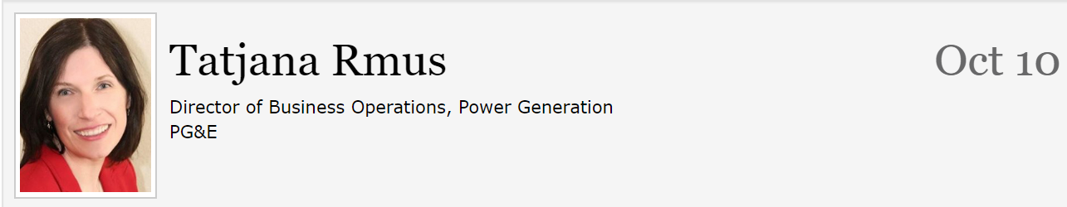
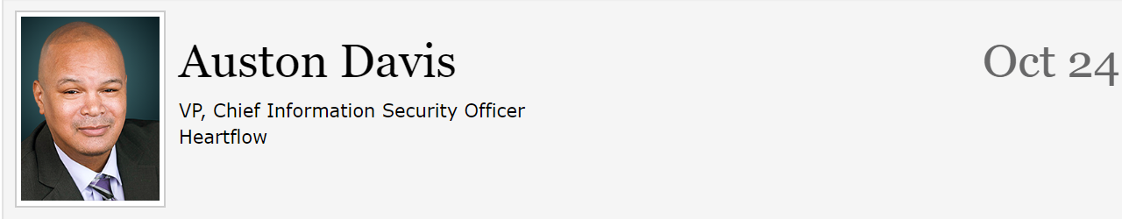
Issues and Reminders (Just a courtesy, not a requirement for lecturer to remind you)
Due date for Midterm Draft moved back to Oct 13@ 11:59pm from Oct 10 (Happy Midterms)
Extra Credit Opportunities remaining

Slide 4
Semester Major Items…..(subject to modification)
 | Mid Term | Resume | Final Paper | Final Presentation (slides )
Topic Paragraph | 9.5.19
Topic Proposed | 9.12.19 |  | 10.3.19
Topic Final | 9.19.19 |  | 10.10.19
Outline/ Abstract | 9.26.19 |  | 10.31.19
Research | 10.1.19 | 10.24.19 (Class) | 10.15.19
Draft Complete | 10.13.19 ** |  | 11.7.19 | 11.19.19
Final Submit | 10.22.19 | 11.14.19 | 11.26.19 | 12.3.19
Final Presentation | NA | NA | NA | 12.17.19 (Sect 1) 12.12.19 (Sect 2)

Slide 5
First 5 page Proposal A Concise version of a Business Plan
Outline | Outline/ Abstract | Draft (5 pages) | Midterm paper (5 pages) | Final Paper ? 15 pages
1. Abstract | Paragraph | ½ page max | ½ page max
2. Executive Summary | paragraph | ½ to 1 page | ½ to 1 page
3. Product Description | 2 paragraphs or so | 1-3 pages
4 Mkt Research and Analysis | 1-2 paragraphs (5 sources min) | 1-3 pages | Depends on sources
5. Finance and Economics | Short paragraph | ½ to 1 page
6. Management Team | Short paragraph | ½ page
7. Risks and Assumptions | Short paragraph | ½ page
8. Conclusions and Recommendations | Short paragraph | ¼ to ½ page
A. Sources | Not Applicable | ½ to 1 page | ½ to 1 page
The outline endures while the content grows

Slide 6
Midterm: First Draft
A first complete paper with all the elements in the outline in the right proportions
Structurally in the final form
Topic Sentences have final content, but may be “tightend up in final”
Read topic sentences of Draft and get the flow of the paper
Set up for success, but not “polished”
Abstract, Executive Summary, Conclusion are finalized last, after the Body of the paper
Body (Product Proposal and Market/product research are complete in content, but not necessarily as concise as the final)
Draft likely longer than Final
Add conciseness: Reduce wordiness/filler, remove/rewrite words to make simpler

Slide 7
Midterm: Content Checklist
Item | CHECKLIST ITEM
[a] | Abstract: Motivation Sentence
[b] | Abstract: Problem Statement
[c] | Abstract: Results Sentence
[d] | Abstract: Conclusions Sentence
[e] | Abstract: Keywords
[f] | Executive Summary: Proposal Background
[g] | Executive Summary: Problem Statement
[h] | Executive Summary: Financial statement related to the proposal
[i] | Executive Summary: Recommended action for “boss”
[j] | Product Description: Product Description (underline all sentences that apply)
[k] | Product Description: Product Differentiators (what is “special” about the proposed product?
[l] | Conclusion: Recommendation Statement

Slide 8
Midterm: Grammar Items Checklist
It | Description | Checklist Item (to be contained in table at end of the paper)
1 | NO PERSONAL PRONOUNS | Confirm no use of “I, we, me, mine, our, ours, let’s, us, you, your, he, she
2 | No use of “Very” | Confirm no instance of “very”
3 | Avoid Passive Voice | Confirm no passive voice
4 | All paragraphs have at least three sentences | Confirm

Slide 9
Abstract Checklist
Motivation
Why do we care to make this paper?
Goes first if the problem is NOT OBVIOUS, otherwise Problem Statement first
Problem Statement
What problem are you trying to solve?
What is the scope of your paper—specific solution (Product) or a general study of a tech area (Research)
Approach
How did you go about solving or making progress on the problem?
What was the extent of your work?
How far did you go to explore the options
Results
What was your answer?
How was your approach better than other potential approaches?
Faster, Cheaper, smaller, more precise?
Go for concise answers rather than vagueness
Conclusions
What are the implications of your answer?
Is it going to change the world, be a nice hack or simply serve that this approach is not the way to go?
Are your results applicable only to your issue or across a large spectrum of problems/ opportunities

Slide 10
Autonomous Vehicle Navigation
ABSTRACT— [a] This paper describes a system that navigates the vehicle autonomously. Autonomous vehicle navigation has gained increasing importance in modern transportation systems. [b]In non-urban domains such as deserts, the problem of successful GPS-based navigation appears to be almost solved while navigation in urban domains, particularly in the close vicinity of buildings in dense urban environments, is still a challenging problem. In such situations GPS accuracy significantly drops down due to the impaired GPS signal. [c]This system provides a communication between the vehicle and the internet using a GPRS modem. This navigation system is interfaced with OSRM open source map data through internet. To improve precision of navigation, this system uses location information from inertial sensors to complement basic GPS. The system also uses a rotatable laser range finder for obstacle sensing. This is an internet-connected system that can provide full information to a remote observer. [d]The autonomous vehicle navigation system has broad applications for self driving vehicles due to the higher navigation quality in key urban areas.
[e] KEYWORDS— GPS, GPRS, compass, navigation, localization, inertial, laser

Slide 11
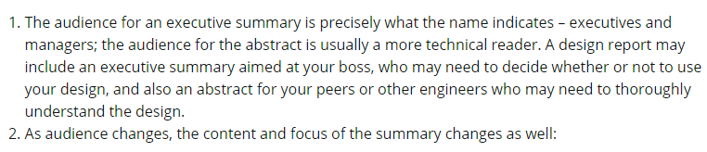
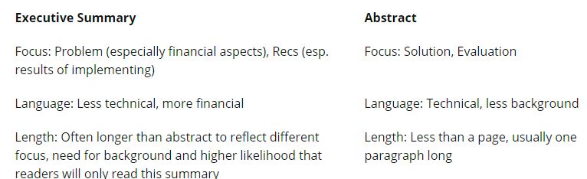
Executive Summary vs Abstract Audience Matters
[g]
[h]
[i]
[c]
[b]

Slide 12
Class Exercise 3.14
For 3.14 (after you submit draft of Midterm 3.12,
Bring a printout of your Abstract, Executive Summary and Conclusion paragraph (s) to class to exchange with team members
Inputs will help craft the final versions of these important paragraphs due 3.19
--------------------------------------------------------------------------
Abstract: Are key contents addressed? Review and mark sentences
Exec Summary: Good structure with topic sentence and concluding sentence. Financial note
Conclusion: Clear ending to paper with CALL TO ACTION

Slide 13
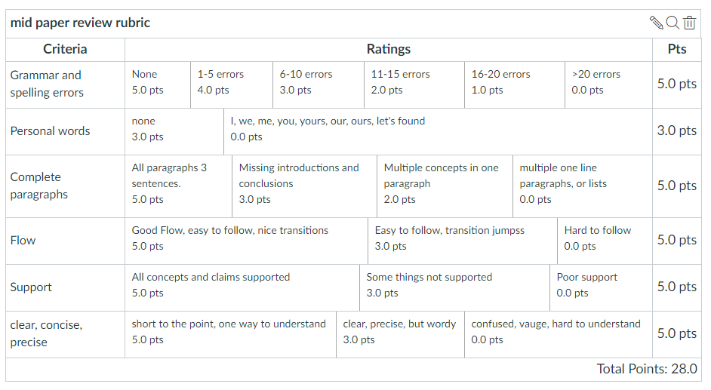
Midterm Paper Rubric

Slide 14
Ethics Case Studies

Slide 15
Expanding the Product Proposal for a Final Paper
Outline | Outline/ Abstract | Draft (5 pages) | Midterm paper (5 pages) | Final Paper ? 15 pages
1. Abstract | Paragraph | ½ page max | ½ page max | 1. Abstract
2. Executive Summary | paragraph | ½ to 1 page | ½ to 1 page | 2.Executive Summary
3. Product Description | 2 paragraphs or so | 1-3 pages |  | 3.0 Product Description (ex.) 3.1 System Description (ex) 3.2 Key technologies 3.3 Functional Description (ex.)
4 Mkt Research and Analysis | 1-2 paragraphs (5 sources min) | 1-3 pages | Depends on sources | 4.0 Mkt Rsch 4.1 Market 4.2 Competitors 4.3 Differentiators
5. Finance and Economics | Short paragraph | ½ to 1 page
6. Management Team | Short paragraph | ½ page
7. Risks and Assumptions | Short paragraph | ½ page
8. Conclusions and Recommendations | Short paragraph | ¼ to ½ page |  | 8. Concl/ Rec’s 8.1 Useful features 8.2 Recommended action
A. Sources | Not Applicable | ½ to 1 page | ½ to 1 page

Slide 16
Framework for Research Option #2
Area of Research
The “container” is the Analysis Process you choose:
-Compare multiple technologies by measuring their performance in a consistent “test” process (Comparative Analysis)
-Measure a single technology’s ability to perform a previously unachievable “test” (Feasibility Study)
Specific Topic
(Describe Specific Research
Research is a fluid.
It has the form of the container you choose.
Criteria for Analysis
ANALYSIS
Results and Implications
Conclusions &Recommendations

Slide 17
Research Challenges
A research paper is more than simply a technical description to explain a complicated technology to others
Requires a level of understanding of the underlying tech as well as its ability to establish value proposition of the technology
Research paper requires more custom work than a product paper
Audience is experts in the field of the research topic
Requires more background than product to broaden the audience
Measurement of success for product is market success while the author must define success for research upfront
The Flow of a proposed research process is different for different topics
AI applied to network security different from AI applied to machine inspection of parts
Elements are similar to product proposal paper, but the author must construct an outline for research that matches the flow of the research itself rather than leverage existing product outline

Slide 18
Case Discussions
--Form up in groups of 3 or 4 with designated leader/spokesperson
--Copyright Case from Academia
--Contemporary Case in Litigation today

Slide 19
Ethics Cases: Engineers and Intellectual Property
Virtue Ethics (from class 13, 14)
Objectivity, Honesty and Care are basic virtues by which “virtuosity” is analyzed
Overall virtue is weighted average of the basic variables
Application/judgment of the weighting factors is driven by phronesis (wisdom) of the investigator
YOU will be challenged to be virtuous by Intellectual Property in your engineering career. Your life and others can be seriously impacted if you do not consider Virtue Ethics at these critical times

Slide 20
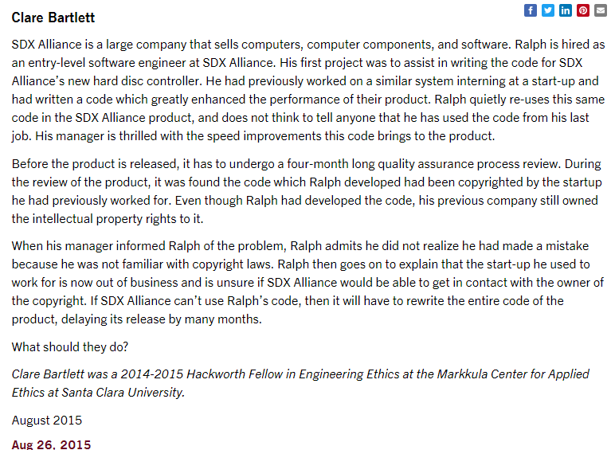
Copyright Issue

Slide 21
Discussion Questions
How would you characterize the behavior of Ralph, his manager, the company?
+How Virtuous was Ralph? Based on what criteria?
+What level of Phronesis did he show?
What are possible outcomes from this work in terms of the software?
How do you rate each potential outcome case in terms of ethics, costs, time to market, and value of the end software?
What approach is ethical and most commercially efficient?
Final Software Composition | Ethics of path chosen (H,L) | Total costs added to Final Product (H, L) | Product Time to market (Delay time) | Value of End Software (1, 2, 3) | Other Impacts/ costs

Slide 22
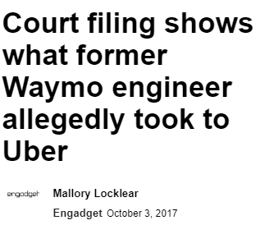
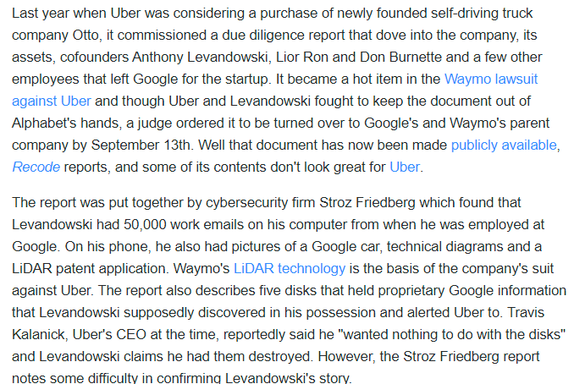
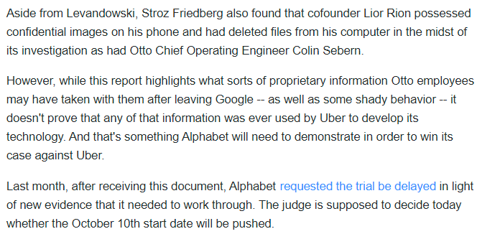

Slide 23
Uber –Otto Case https://finance.yahoo.com/news/court-filing-shows-former-waymo-161100457.html
In 2016, Uber was considering buying a self-driving truck business called Otto
Otto founders were Anthony Levandowski, Lior Ron and Don Burnette, formerly Waymo/Google employees
Uber commissioned a due diligence report related to Otto before buying
In August 2016, Uber closed the deal and bought Otto
Waymo separately sued Uber for IP infringement related to LiDAR and requested access to the due diligence report
Levandowski had 50,000 work emails from his Google employment as well as Google car photos, technical diagrams and a LiDAR patent application
Levandowski also discovered 5 disks in his possession that had Google proprietary info during his relationship with Uber and notified the Uber CEO that “he (Levandowski) wanted them destroyed”
Lior Ron had Google images on his phone and computer that he destroyed during the investigation
In order to win their case against Uber, Waymo/Google must prove that the inputs from the Otto founders were used to develop the Uber LiDAR product(s)
Given that the Uber Due Diligence report was received BEFORE Uber bought Otto, did Uber management display Virtue Ethics in completing the acquisition? Support your answer. If not, what should Uber have done before going forward to acquire Otto? (1/2 page concise statements)
(note: Do NOT provide ethical analysis of Levandowski, Ron and Burnette)

Slide 24
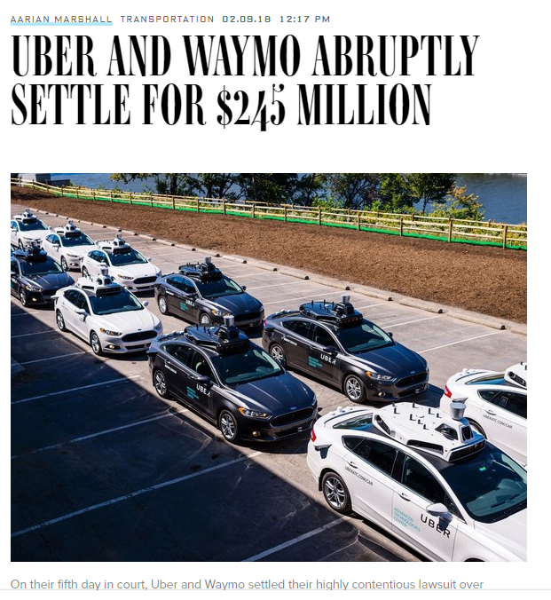
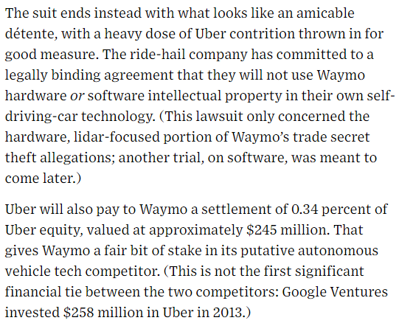
Feb 18, 2018: Settlement!

